Slide 1

intelligent traffic light control system
By Group-14:
Sreeshanth (CB.SC.U4AIE24225)
Sai Vandith (CB.SC.U4AIE24239)
Reshwanth (CB.SC.U4AIE24246)
Kaushik Ram (CB.SC.U4AIE24266)
Subject Name:
DATA STRUCTURES AND ALGORITHMS,OBJECT ORIENTED PROGRAMMING SYSTEM IN JAVA
Subject Code:
22AIE112
22AIE111

Slide 2
Introduction:
Traffic congestion is a major issue in urban areas which leads to increase in travel time ,fuel consumption , and mainly the pollution
Traditional traffic light systems operate on fixed timers, which do not adapt to real-time traffic condition
An Intelligent Traffic Light Control System that dynamically adjusts green light durations based on vehicle density
the system processes traffic data from different directions (North, South, East, and West). The algorithm prioritizes directions with higher vehicle counts, ensuring a fair and efficient allocation of green light time

Slide 3
The system takes input from the dataset containing traffic data. When the user enters a row number, the program automatically retrieves the traffic data for that instance and calculates the optimal green light timings
Roads(Direction) with more vehicles receive longer green signals, while roads with fewer vehicles get shorter ones, ensuring a smooth and fair traffic flow.

Slide 4
Objective:
Adjusts green light duration based on real-time traffic flow.
Reduce waiting time by prioritizing congested roads
Minimize traffic jams by using smart signal adjustments instead of fixed cycle times

Slide 5
Involvement of DSA:
Hash Map :
A hash map (dictionary) stores data in key-value pairs, and allows fast access in O(1) time
In our project, keys are directions ("North", "South", etc.), and values are vehicle counts
Arrays :
An Array is a collection of elements stored in a specific order , It allows easy storage, access
We used an array to store and sort traffic data in descending order based on vehicle count
Sorting :
Sorting the vehicle counts to the determine priority order

Slide 6
Implementation of OOP Concept: Class and Object :
We created the Intelligent Traffic Light class to manage traffic data
we created an object traffic-system using the class
Constructor :
The “init” method is a constructor that runs automatically when we create an object
It initializes the object and loads traffic data from the CSV file
Abstraction :
Users only need to call calculate-green-light(row number) to get results
To hide how the traffic data is loaded or processed internally

Slide 7
Flow Chart:
Load Traffic Dataset
User Inputs Row Number
Extract Traffic Data for Given Row
Sort Directions Based on Vehicle Count
Calculate Green Light Time
Display Green Light Timing

Slide 8
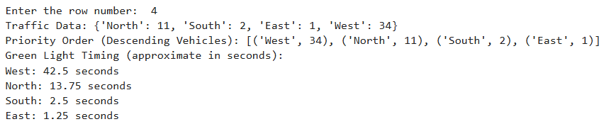
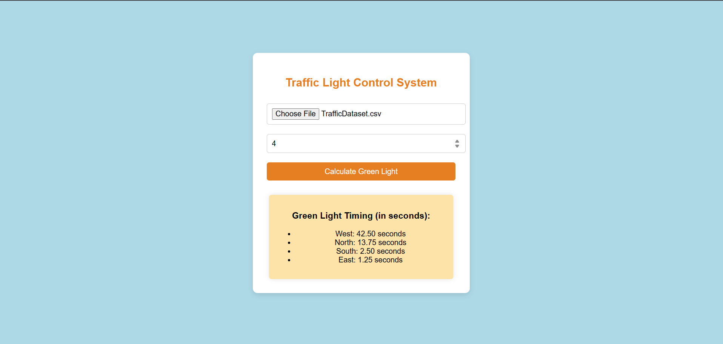
Results:
Python Code Results
UI Page Results

